Slide 1
Applications of Deep Reinforcement Learning in Communications and Networking: A Survey
IEEE Communications Surveys & Tutorials
2019
Notes:
https://drive.google.com/drive/u/1/folders/1R5YWx4L6T0RWRFPd4-UJ-vU2FoK93swB

Slide 2
Deep Reinforcement Learning (DRL)

Slide 3
DRL can obtain the solution of sophisticated network optimizations. Thus, it enables network controllers, e.g., base stations, in modern networks to solve non-convex and complex problems, e.g., joint user association, computation, and transmission schedule, to achieve the optimal solutions without complete and accurate network information.
DRL allows network entities to learn and build knowledge about the communication and networking environment. Thus, by using DRL, the network entities, e.g., a mobile user, can learn optimal policies, e.g., base station selection, channel selection, handover decision, caching and offloading decisions, without knowing channel model and mobility pattern.

Slide 4
DRL provides autonomous decision-making. With the DRL approaches, network entities can make observation and obtain the best policy locally with minimum or without information exchange among each other. This not only reduces communication overheads but also improves security and robustness of the networks.
DRL improves significantly the learning speed, especially in the problems with large state and action spaces. Thus, in large-scale networks, e.g., IoT systems with thousands of devices, DRL allows network controller or IoT gateways to control dynamically user association, spectrum access, and transmit power for a massive number of IoT devices and mobile users.

Slide 5
Several other problems in communications and networking such as cyber-physical attacks, interference management, and data offloading can be modeled as games, e.g., the non-cooperative game. DRL has been recently used as an efficient tool to solve the games, e.g., finding the Nash equilibrium, without the complete information.

Slide 6
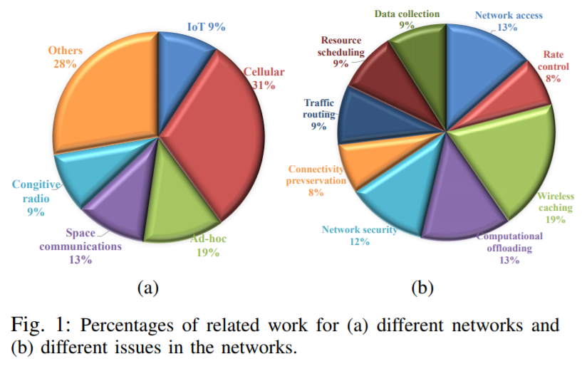

Slide 7
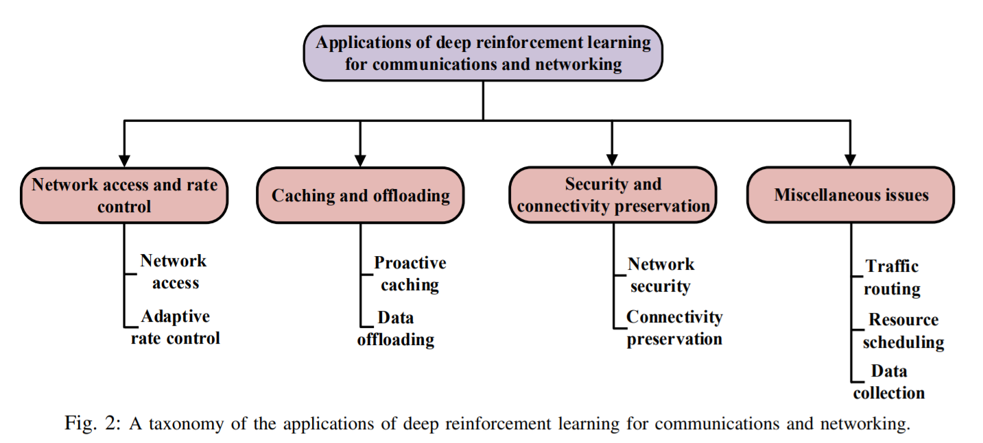

Slide 8
Deep Reinforcement Learning (DRL)
Markov Decision Processes
Reinforcement Learning
Deep Learning
Deep Q-Learning
Advanced Deep Q-Learning Models
Deep Q-Learning for Extensions of MDPs

Slide 9
Markov Decision Processes
Partially Observable Markov Decision Process
Markov Games

Slide 10
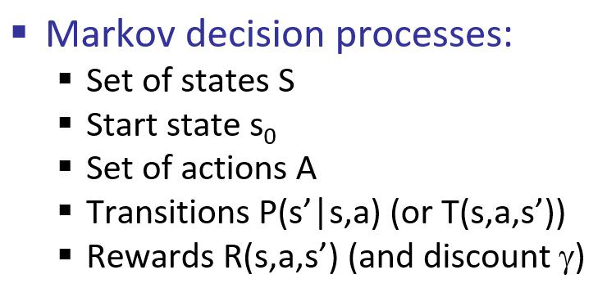
Notes:
https://blog.techbridge.cc/2018/10/27/intro-to-mdp-and-app/

Slide 11
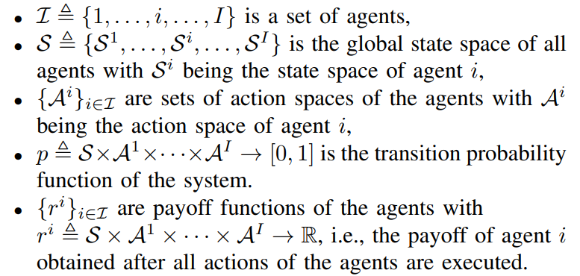
Markov Games

Slide 12
Reinforcement Learning
Q-Learning Algorithm
SARSA
Q-Learning for Markov Games

Slide 13
Deep Learning
Artificial Neural Network (ANN)
DNN
Feedforward Neural Network (FNN)
Convolutional Neural Network (CNN)
Recurrent Neural Network (RNN)
Long Short-Term Memory (LSTM)

Slide 14
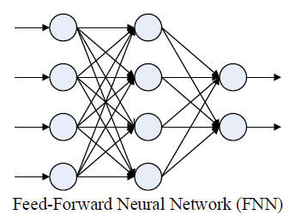
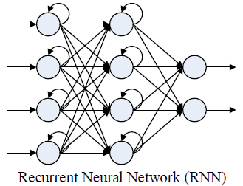
Deep Learning

Slide 15
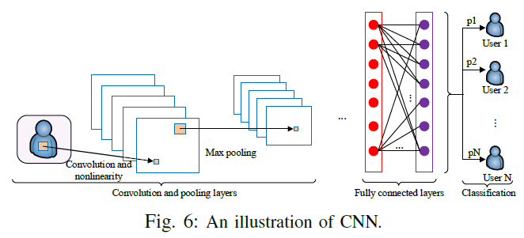

Slide 16
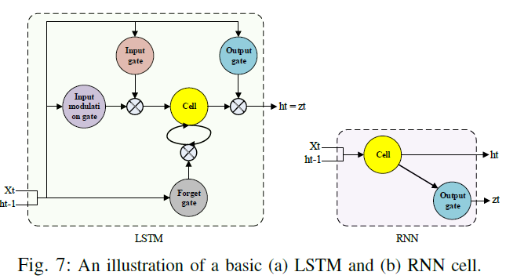

Slide 17
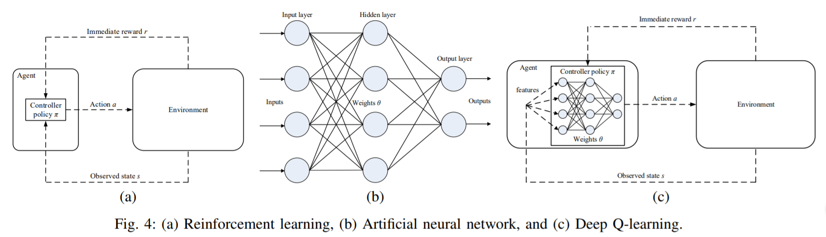
(a) Reinforcement learning, (b) Artificial neural network, and (c) Deep Q-learning

Slide 18
Reinforcement learning

Slide 19
Artificial neural network

Slide 20
Deep Q-learning

Slide 21
Deep Q-Learning
Experience replay mechanism
Fixed target Q-network

Slide 22
Advanced Deep Q-Learning Models
Double Deep Q-Learning (DDQL)
Deep Q-Learning with Prioritized Experience Replay
Dueling Deep Q-Learning
Asynchronous Multi-step Deep Q-Learning
Distributional Deep Q-learning
Deep Q-learning with Noisy Nets
Rainbow Deep Q-learning

Slide 23
Deep Q-Learning for Extensions of MDPs
Deep Deterministic Policy Gradient Q-Learning for Continuous Action
Deep Recurrent Q-Learning for POMDPs
Deep SARSA Learning
Deep Q-Learning for Markov Games

Slide 24
NETWORK ACCESS AND RATE CONTROL
Dynamic spectrum access
Joint user association and spectrum access
Adaptive rate control

Slide 25
NETWORK ACCESS AND RATE CONTROL

Slide 26
NETWORK ACCESS AND RATE CONTROL
Dynamic spectrum access: Dynamic spectrum access allows users to locally select channels to maximize their throughput. However, the users may not have full observations of the system, e.g., channel states. Thus, DQL can be used as an effective tool for dynamic spectrum access.
Joint user association and spectrum access: User association is implemented to determine which user to be assigned to which Base Station (BS). The joint user association and spectrum access problems are studied in [42] and [43]. However, the problems are typically combinatorial and non-convex which require nearly complete and accurate network information to obtain the optimal strategy. DQL is able to provide distributed solutions which can be effectively used for the problems.

Slide 27
NETWORK ACCESS AND RATE CONTROL
Adaptive rate control: This refers to bitrate/data rate control in dynamic and unpredictable environments such as Dynamic Adaptive Streaming over HTTP (DASH). Such a system allows clients or users to independently choose video segments with different bitrates to download. The client’s objective is to maximize its Quality of Experience (QoE). DQL can be adopted to effectively solve the problem instead of dynamic programming which has high complexity and demands complete information.

Slide 28
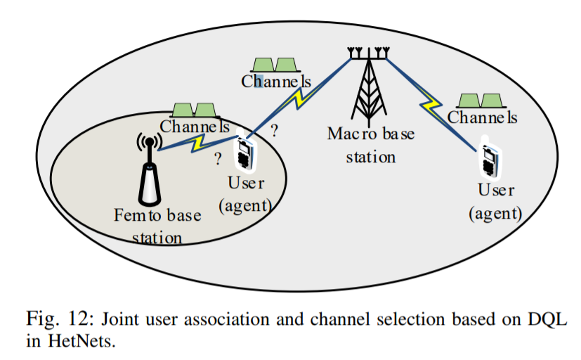

Slide 29
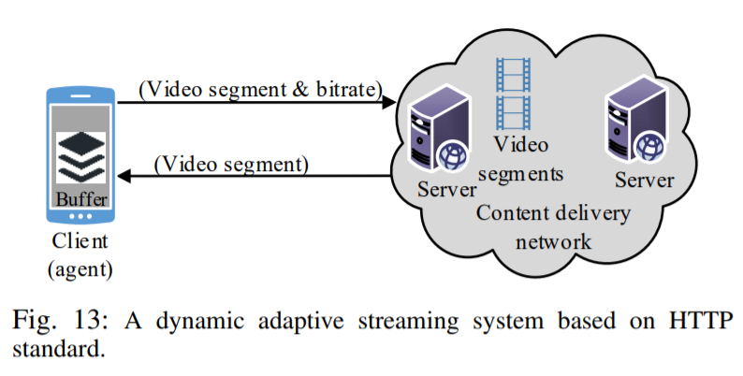

Slide 30
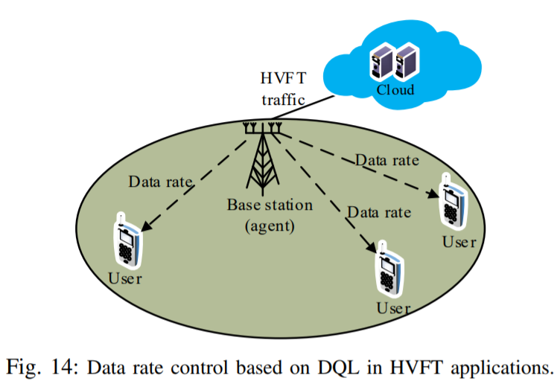

Slide 31
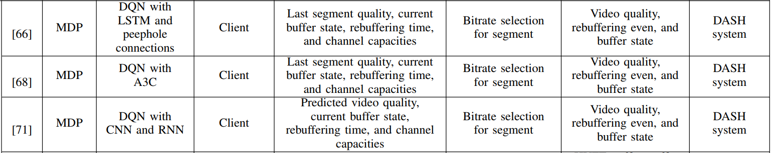

Slide 32
Reinforcement Learning
Agent: The player/bot that interacts with the environment and makes the decisions
Environments: The environment that the agent interacts with
Actions: The action performed by the agent
Observations: The new states after the actions are carried out
Rewards: The value that the agent tries to maximize during training of the agent
Notes:
https://medium.com/@samsam23122001/reinforcement-learning-deep-q-learning-749f212fc73b

Slide 33
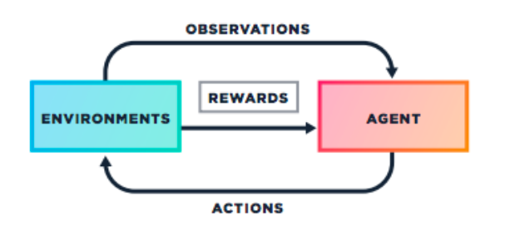

Slide 34
Reinforcement Learning
Agent: The player/bot that interacts with the environment and makes the decisions
Environments: The environment that the agent interacts with
Actions: The action performed by the agent
Observations: The new states after the actions are carried out
Rewards: The value that the agent tries to maximize during training of the agent
Notes:
https://medium.com/@samsam23122001/reinforcement-learning-deep-q-learning-749f212fc73b

Slide 36
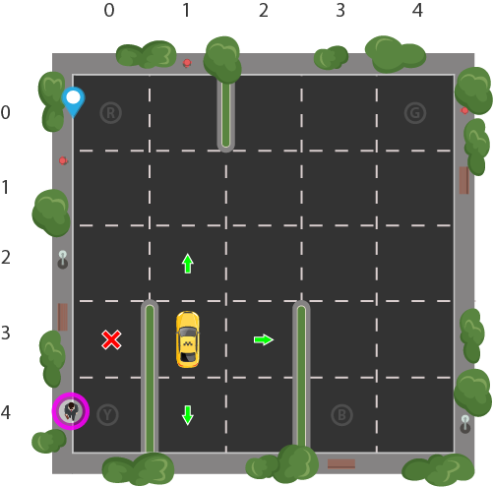

Slide 37
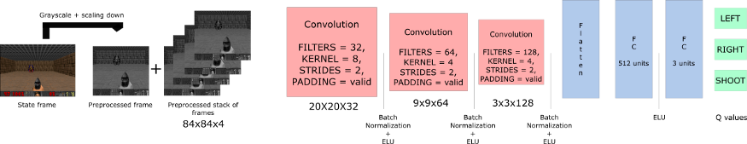
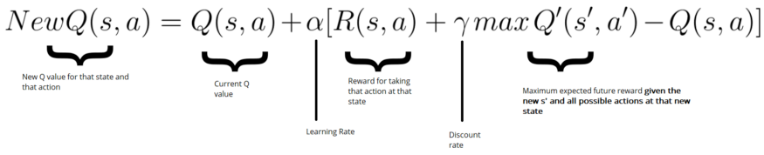
Deep Q-learning

Slide 38
 | Q-learning
 | state space and action space are small

Slide 39
Reinforcement Learning

Slide 40
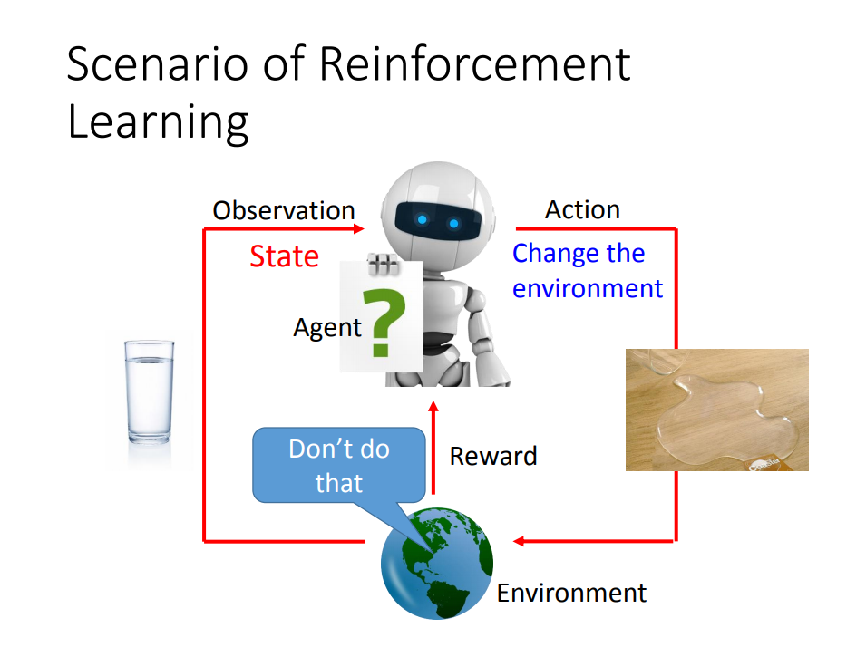

Slide 41
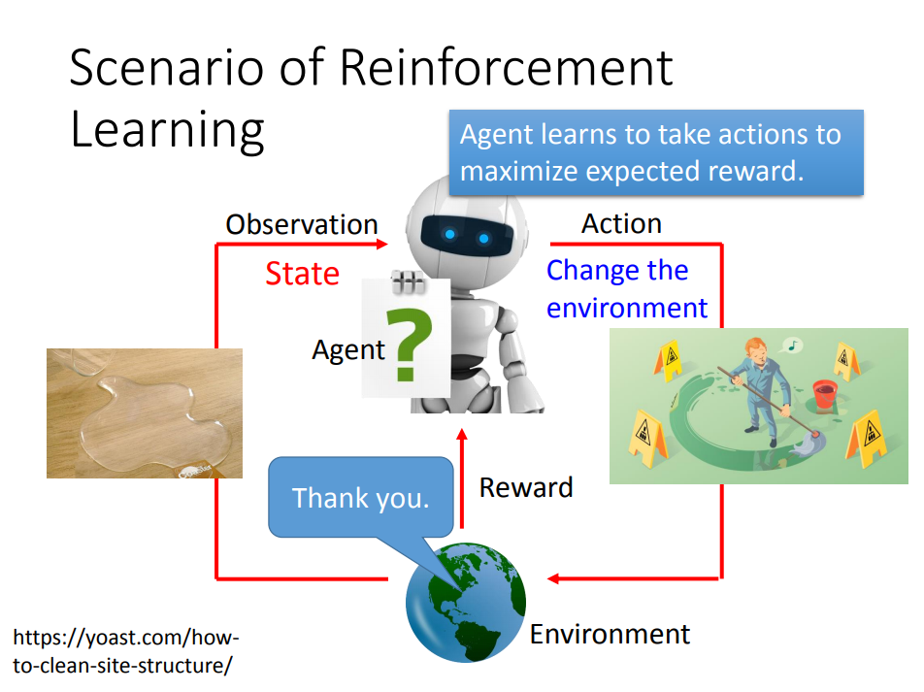

Slide 42
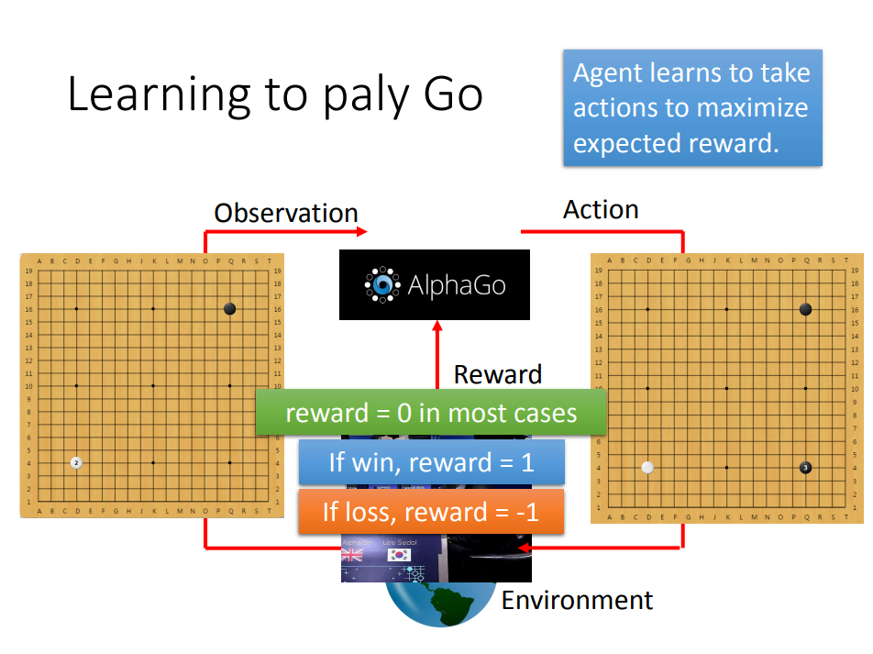

Slide 43
Reinforcement Learning
Agent: The player/bot that interacts with the environment and makes the decisions
Environments: The environment that the agent interacts with
Actions: The action performed by the agent
Observations: The new states after the actions are carried out
Rewards: The value that the agent tries to maximize during training of the agent
Notes:
https://medium.com/@samsam23122001/reinforcement-learning-deep-q-learning-749f212fc73b

Slide 44
Reinforcement learning

Slide 45
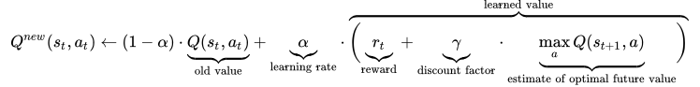
Q-learning (Value-based)

Slide 46
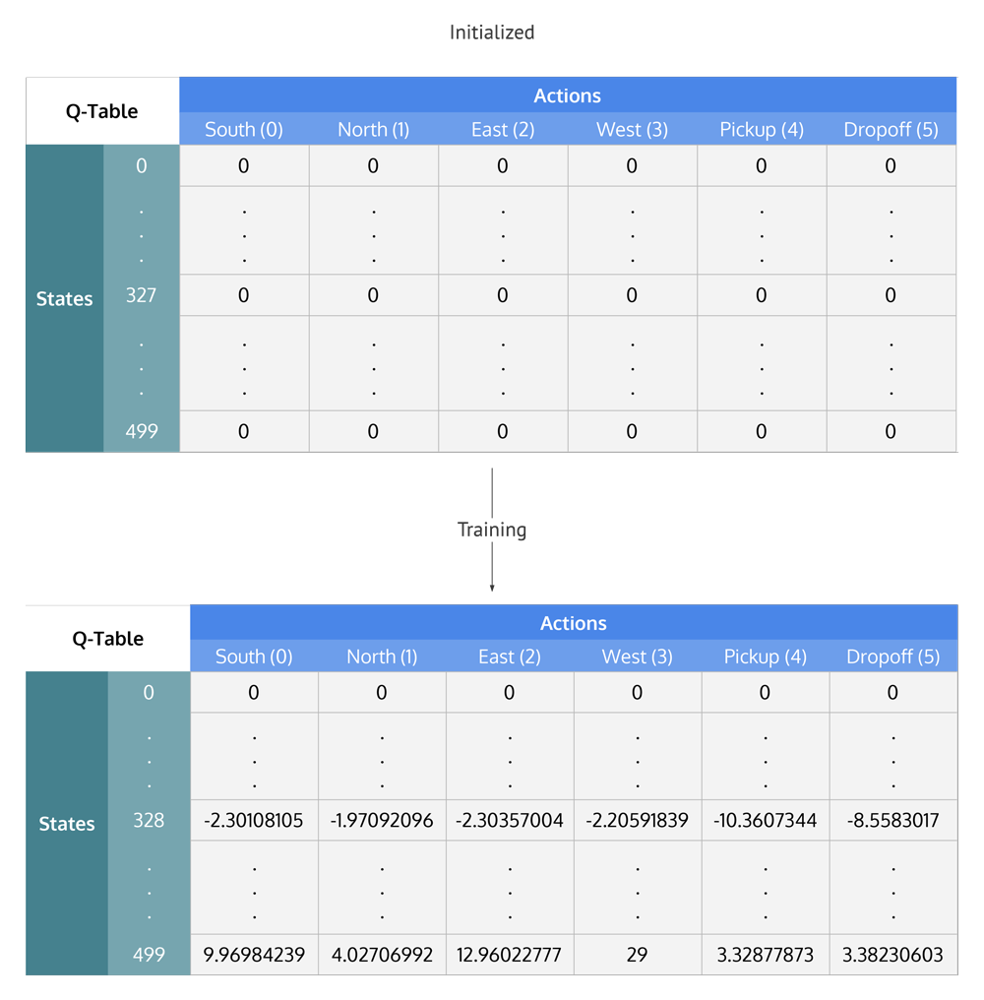

Slide 47
Artificial neural network

Slide 48
Deep RL

Slide 49
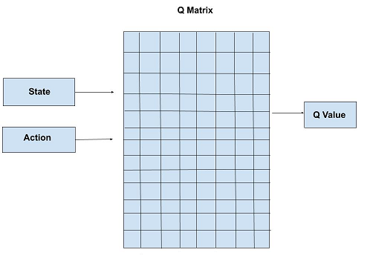
Q-learning (Tabular)

Slide 50
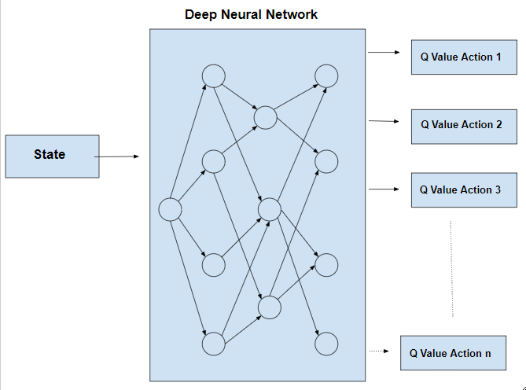
Deep Q-Learning

Slide 51
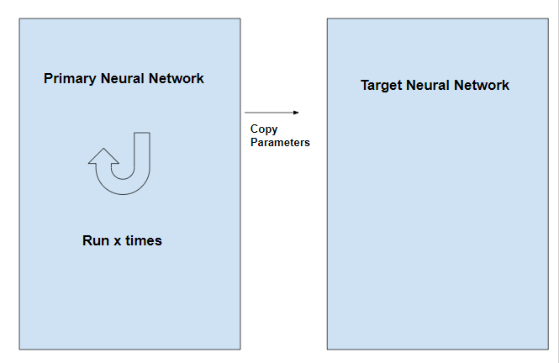

Slide 52
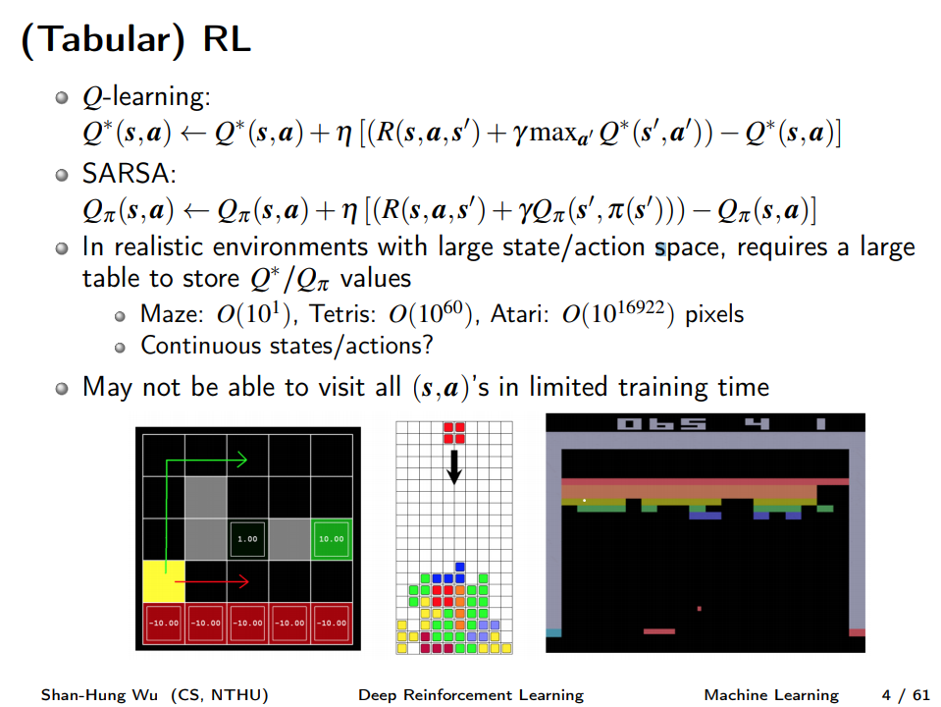

Slide 53
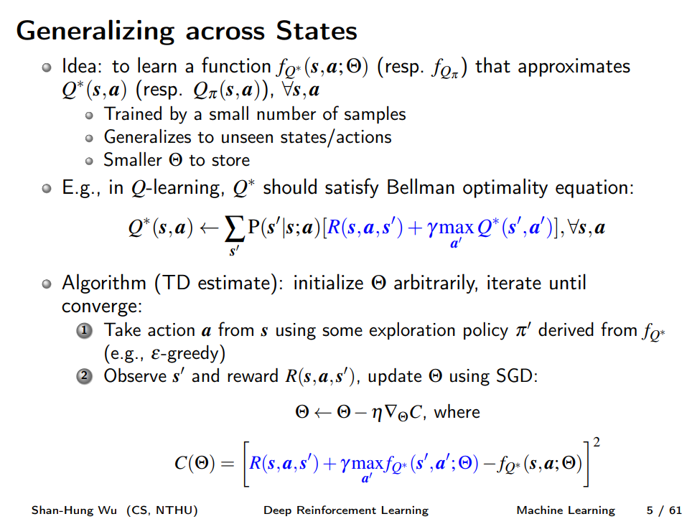

Slide 54
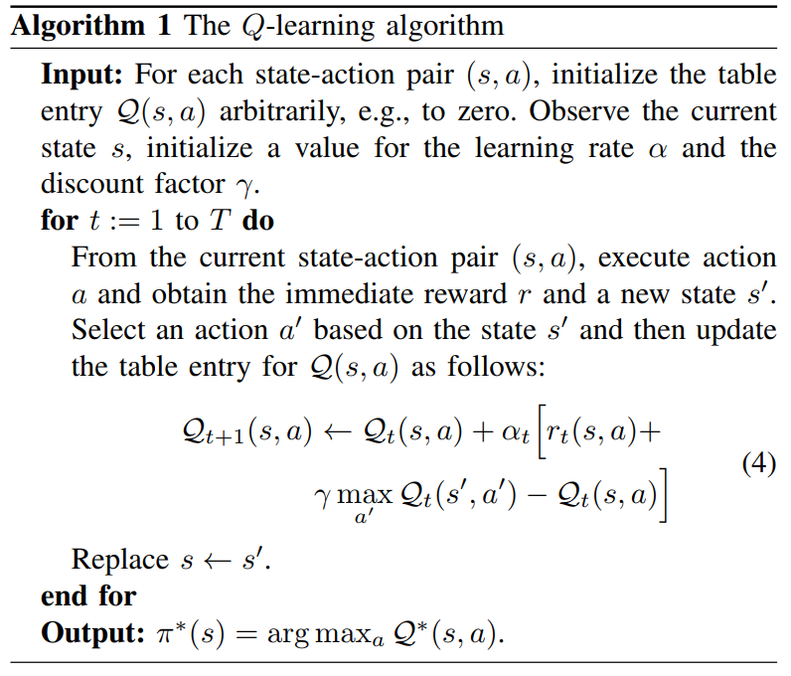

Slide 55
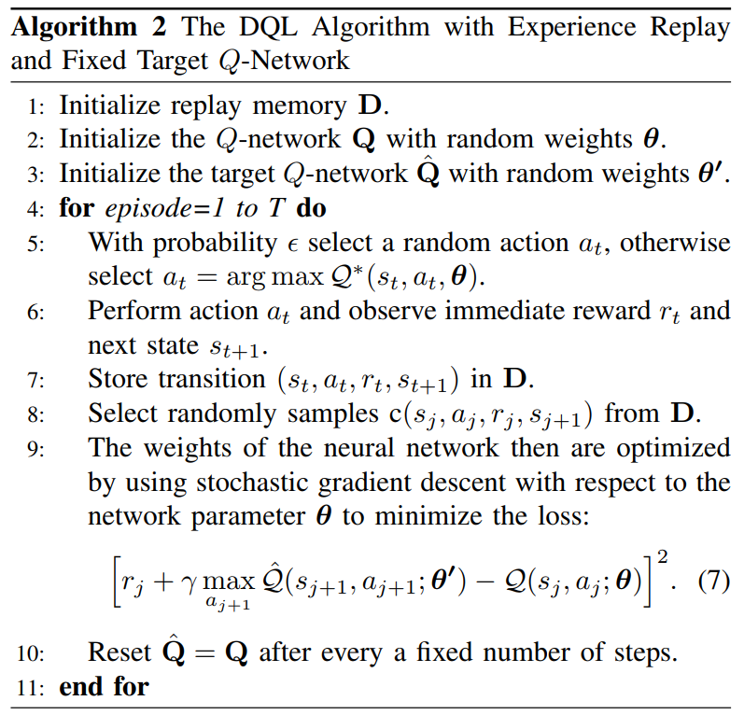

Slide 56
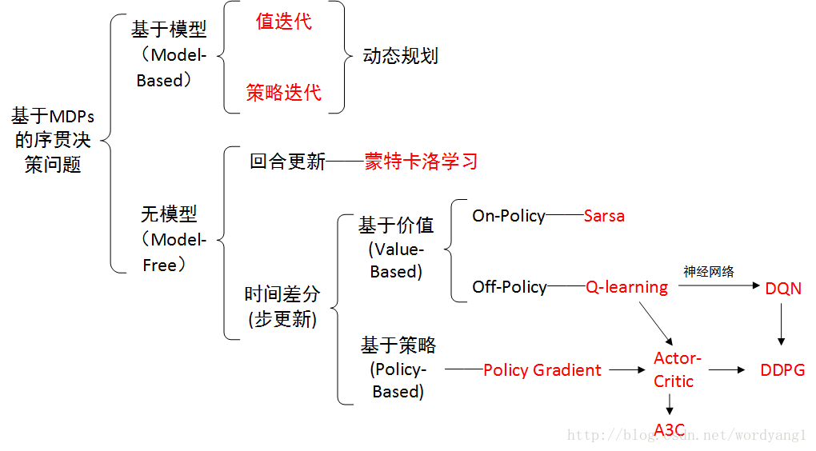
Notes:
https://blog.csdn.net/wordyang1/article/details/76557608

Slide 57
Deep Reinforcement Learning for User Association and Resource Allocation in Heterogeneous Networks
2018 IEEE Global Communications Conference (GLOBECOM)

Slide 58
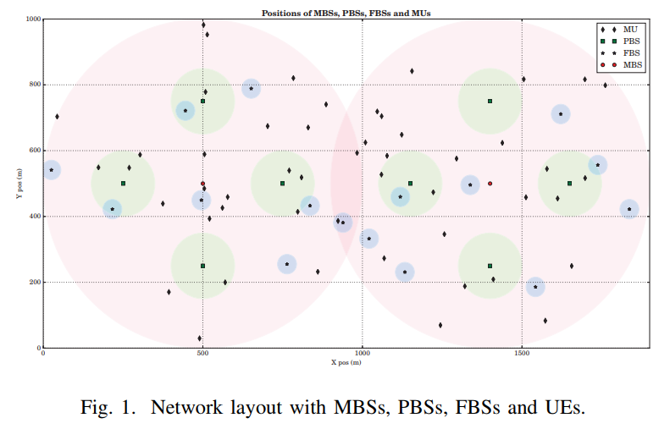
Scenario
Consider a HetNet which consists of multiple users and BSs including macro base stations and femto base stations. The BSs share a set of orthogonal channels, and the users are randomly located in the network.

Slide 59
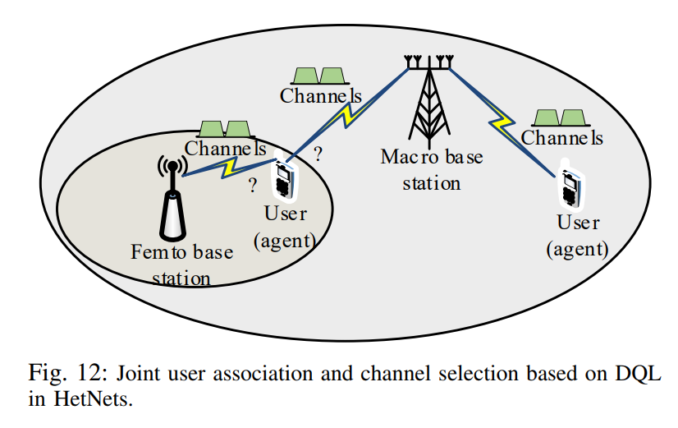
Scenario
Consider a HetNet which consists of multiple users and BSs including macro base stations and femto base stations. The BSs share a set of orthogonal channels, and the users are randomly located in the network.
The problem of each user is to select one BS and a channel to maximize its data rate while guaranteeing that the SINR of the user is higher than a minimum QoS requirement.

Slide 60
System Model
The Set of all BSs is denoted as
all BSs operate on K shared orthogonal channels
serve N UEs
Notes:
Assume that all BSs and UEs are equipped with one antenna each shared orthogonal channels.

Slide 61
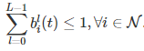
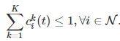
System Model
The Set of all BSs is denoted as
all BSs operate on K shared orthogonal channels
serve N UEs
Each UE can only select at most one BS at any time.
Each UE can only access to no more than one channel.
Notes:
1.Assume that all BSs and UEs are equipped with one antenna each shared orthogonal channels.
2.Although the number of UEs operating simultaneously on the same channel is unlimited

Slide 62
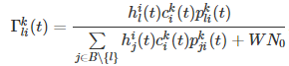
System Model
The instantaneous signal-to-interference-plus-noise ratio (SINR) at the UEi from BSl using Ck is
Notes:
Shannon–Hartley theorem(https://en.wikipedia.org/wiki/Shannon%E2%80%93Hartley_theorem)

Slide 63
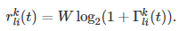
System Model
The instantaneous signal-to-interference-plus-noise ratio (SINR) at the UEi from BSl using Ck is
The downlink rate of the i-th UE from BSl on the channel Ck can be achieved as,
Notes:
Shannon–Hartley theorem(https://en.wikipedia.org/wiki/Shannon%E2%80%93Hartley_theorem)

Slide 64
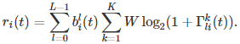
System Model
The instantaneous signal-to-interference-plus-noise ratio (SINR) at the UEi from BSl using Ck is
The downlink rate of the i-th UE from BSl on the channel Ck can be achieved as,
The total available rate of UEi is
Notes:
Shannon–Hartley theorem(https://en.wikipedia.org/wiki/Shannon%E2%80%93Hartley_theorem)

Slide 65
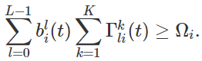
Problem Formulation
UEi can obtain the SINR Γi(t) at least as much as the munimum Qos requirements Ωi,
Notes:
1. pkli(t) is the transmit power of BSl
2.λl is the unit price of the BSl 's transmit power
3. ∈[0,1) is the discount factor.
γ=0 means that the reward is the immediate reward associated with the current state only.
When γ<1, the rewards in the future are less than the rewards of the earlier periods.

Slide 66
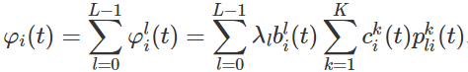
Problem Formulation
UEi can obtain the SINR Γi(t) at least as much as the munimum Qos requirements Ωi,
The total cost of UEi is
Notes:
1. pkli(t) is the transmit power of BSl
2.λl is the unit price of the BSl 's transmit power
3. ∈[0,1) is the discount factor.
γ=0 means that the reward is the immediate reward associated with the current state only.
When γ<1, the rewards in the future are less than the rewards of the earlier periods.

Slide 67
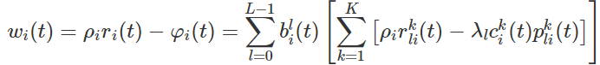
Problem Formulation
UEi can obtain the SINR Γi(t) at least as much as the munimum Qos requirements Ωi,
The total cost of UEi is
The i-th UE's utility wi(t) as the difference between the achievable profit and the cost,
Notes:
1. pkli(t) is the transmit power of BSl
2.λl is the unit price of the BSl 's transmit power
3. ∈[0,1) is the discount factor.
γ=0 means that the reward is the immediate reward associated with the current state only.
When γ<1, the rewards in the future are less than the rewards of the earlier periods.

Slide 68
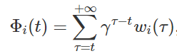
Problem Formulation
UEi can obtain the SINR Γi(t) at least as much as the munimum Qos requirements Ωi,
The total cost of UEi is
The i-th UE's utility wi(t) as the difference between the achievable profit and the cost,
Goal: maximize its long-term reward Φi(t) as a sum of the instantaneous rewards over an infinite period, that is,
Notes:
1. pkli(t) is the transmit power of BSl
2.λl is the unit price of the BSl 's transmit power
3. ∈[0,1) is the discount factor.
γ=0 means that the reward is the immediate reward associated with the current state only.
When γ<1, the rewards in the future are less than the rewards of the earlier periods.

Slide 69
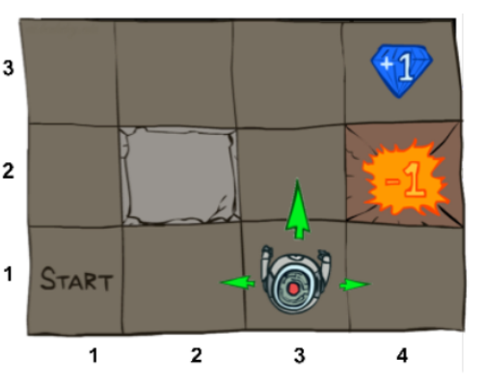
Reinforcement Learning
Agent: The player/bot that interacts with the environment and makes the decisions
Environments: The environment that the agent interacts with
Actions: The action performed by the agent
Observations: The new states after the actions are carried out
Rewards: The value that the agent tries to maximize during training of the agent
Notes:
https://medium.com/@samsam23122001/reinforcement-learning-deep-q-learning-749f212fc73b

Slide 70
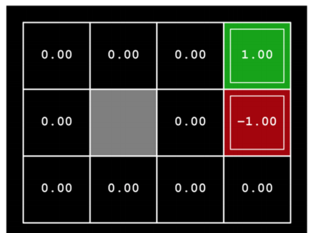
Example

Slide 71
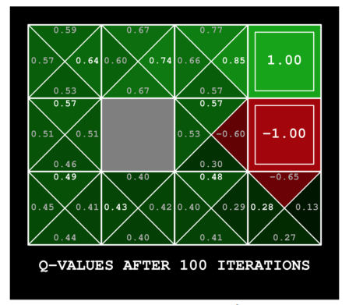
Example

Slide 72
Reinforcement Learning

Slide 73
Q-learning (Tabular)
Notes:
1.In realistic environments with large state/action space, requires a large table to store Q ∗/Qπ values
2.May not be able to visit all (s,a)’s in limited training time

Slide 74
Deep Q-Learning
Notes:
Idea: to learn a function fQ∗ (s,a;Θ) (resp. fQπ ) that approximates Q ∗ (s,a) (resp. Qπ (s,a)), ∀s,a
1.Trained by a small number of samples
2.Generalizes to unseen states/actions
3.Smaller theta to store

Slide 75
Deep RL

Slide 76
Reinforcement Learning
Agent: Mobile user
Environments: Heterogeneous Network
Actions: Base station and channel selection
Observations: all UEs’ QoS states
Rewards: Utility (data rate - action cost)

Slide 77
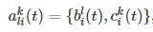
Basic Model(Reinforcement Learning)
1) State Space
The degree of satisfaction of all UEs' QoS as the state s(t),
2) Action Space Considering that all UEs decide to select the BSs and transmission channels, the action of each agent can be defined as
3) Reward
Considering that each UE may consume certain cost when selecting certain action, we define Ri(t) as
Notes:
1.2^N
2.2^(L+K)
3. Ψi>0 denotes the i-th UE's action-selection cost.
This reward function guarantees the minimum QoS of the HetNet as well as obtaining UEs' maximum utilities.

Slide 78
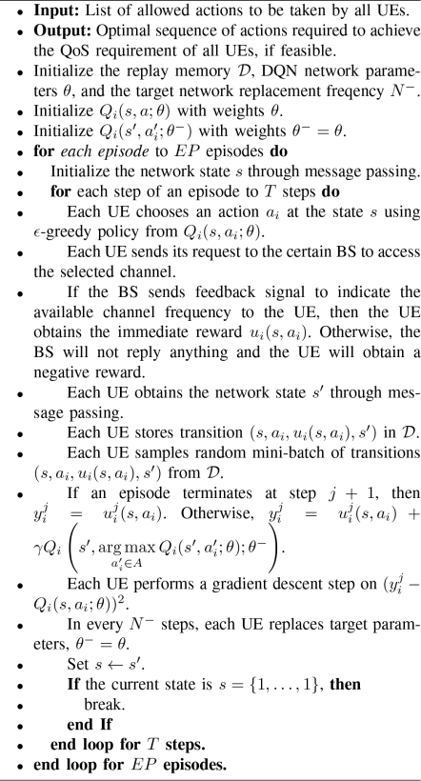

Slide 79
Algorithm
At the beginning of each episode, - the network state is initialized through message passing. - By using a pilot signal, each UE can measure the received power from the associated BS and the randomly-selected channel. - Each UE reports its own current state to its current associated BS. - By the message passing between the BSs through the backhaul communication link, the global state information of all UEs is obtained. - The BSs send this global state information s to all UEs.

Slide 80
Algorithm
In each step
1. All UEs obtain the estimated Qi(s, ai; θ) for all actions.
2. The ϵ-greedy policy is used to choose the action ai. - It is necessary for each UE to send its request to the BS with which the UE has chosen to associate. - The request contains the index of the required channel.
3. The BSs chooses to accept or reject the requests, which depends on their available resource. - If the BSl accepts the request of the i-th UE, the BSl will send feedback signal to indicate the available channel to the i-th UE. - Otherwise, the BSl will not reply anything.

Slide 81
Algorithm
4. When each UE obtains the reward ui(s,ai) and observes the next state s′,
5. (s, ai, ui(s, ai), s′) will be stored into the replay memory D
6. Each UE updates weights θ with the random mini-batch samples from the replay memory D

